Slide 1
Boolean Algebra, Digital Logic

Slide 2
Objectives
Understand the relationship between Boolean logic and digital computer circuits.
Learn how to design simple logic circuits.
Understand how digital circuits work together to form complex computer systems.

Slide 3
Boolean Algebra
Boolean algebra is a mathematical system for the manipulation of variables that can have one of two values.
  In formal logic, these values are “true” and “false.”
  In digital systems, these values are “on” and “off,” 1 and 0, or “high” and “low.”
Boolean expressions are created by performing operations on Boolean variables.
  Common Boolean operators include AND, OR, and NOT.

Slide 4
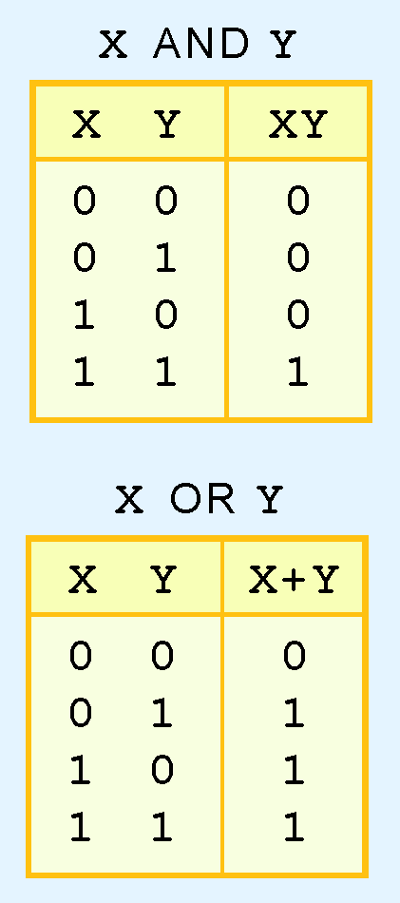
Boolean Algebra
A Boolean operator can be completely described using a truth table.
The truth table for the Boolean operators AND and OR are shown at the right.
The AND operator is also known as a Boolean product. The OR operator is the Boolean sum.

Slide 5
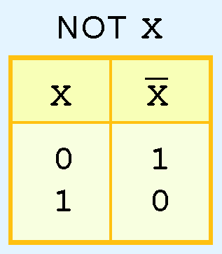
Boolean Algebra
The truth table for the Boolean NOT operator is shown at the right.
The NOT operation is most often designated by an overbar.

Slide 6
Boolean Algebra
A Boolean function has:
  At least one Boolean variable,
  At least one Boolean operator, and
  At least one input from the set {0,1}.
It produces an output that is also a member of the set {0,1}.
Now you know why the binary numbering system is so handy in digital systems.

Slide 7
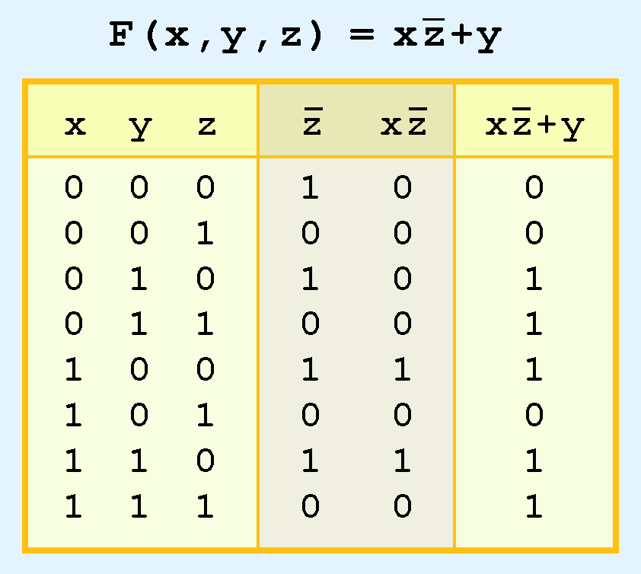
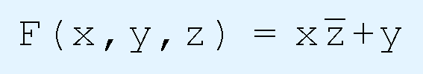
Boolean Algebra
The truth table for the Boolean function:
is shown at the right.
To make evaluation of the Boolean function easier, the truth table contains extra (shaded) columns to hold evaluations of subparts of the function.

Slide 8
Boolean Algebra
As with common arithmetic, Boolean operations have rules of precedence.
The NOT operator has highest priority, followed by AND and then OR.
This is how we chose the (shaded) function subparts in our table.

Slide 9
Boolean Algebra
Digital computers contain circuits that implement Boolean functions.
We can simplify the circuits using Boolean function simplification.
  Simpler circuits are cheaper to build, consume less power, and run faster than complex circuits.
With this in mind, we always want to reduce our Boolean functions to their simplest form.
There are a number of Boolean identities that help us to do this.

Slide 10
Boolean Algebra
Most Boolean identities have an AND (product) form as well as an OR (sum) form. Table shows the first identity:
Identity Name | AND Form | OR Form
Identity Law | 1 X = X | 0 + X = X
Idempotent Law | X X = X | X + X = X
Inverse Law | X X’ = 0 | X + X’ = 1

Slide 11
Boolean Algebra
The second group of Boolean identities are:
Identity Name | AND Form | OR Form
Commutative Law | X Y = Y X | X + Y = Y + X
Associative Law | (X Y) Z = X (Y Z) | (X + Y) + Z = X + ( Y + Z)
Distributive Law | X + Y Z = ( X + Y) (X + Z) | X (Y + Z) = X Y + X Z

Slide 12
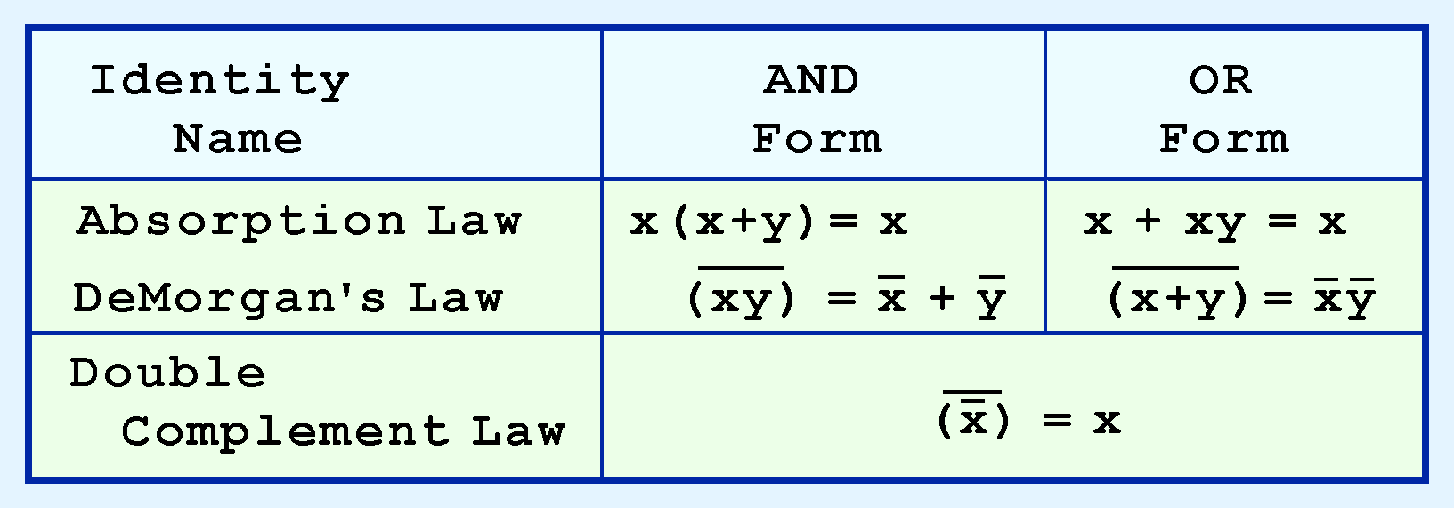
Boolean Algebra
Our last group of Boolean identities are perhaps the most useful.

Slide 13

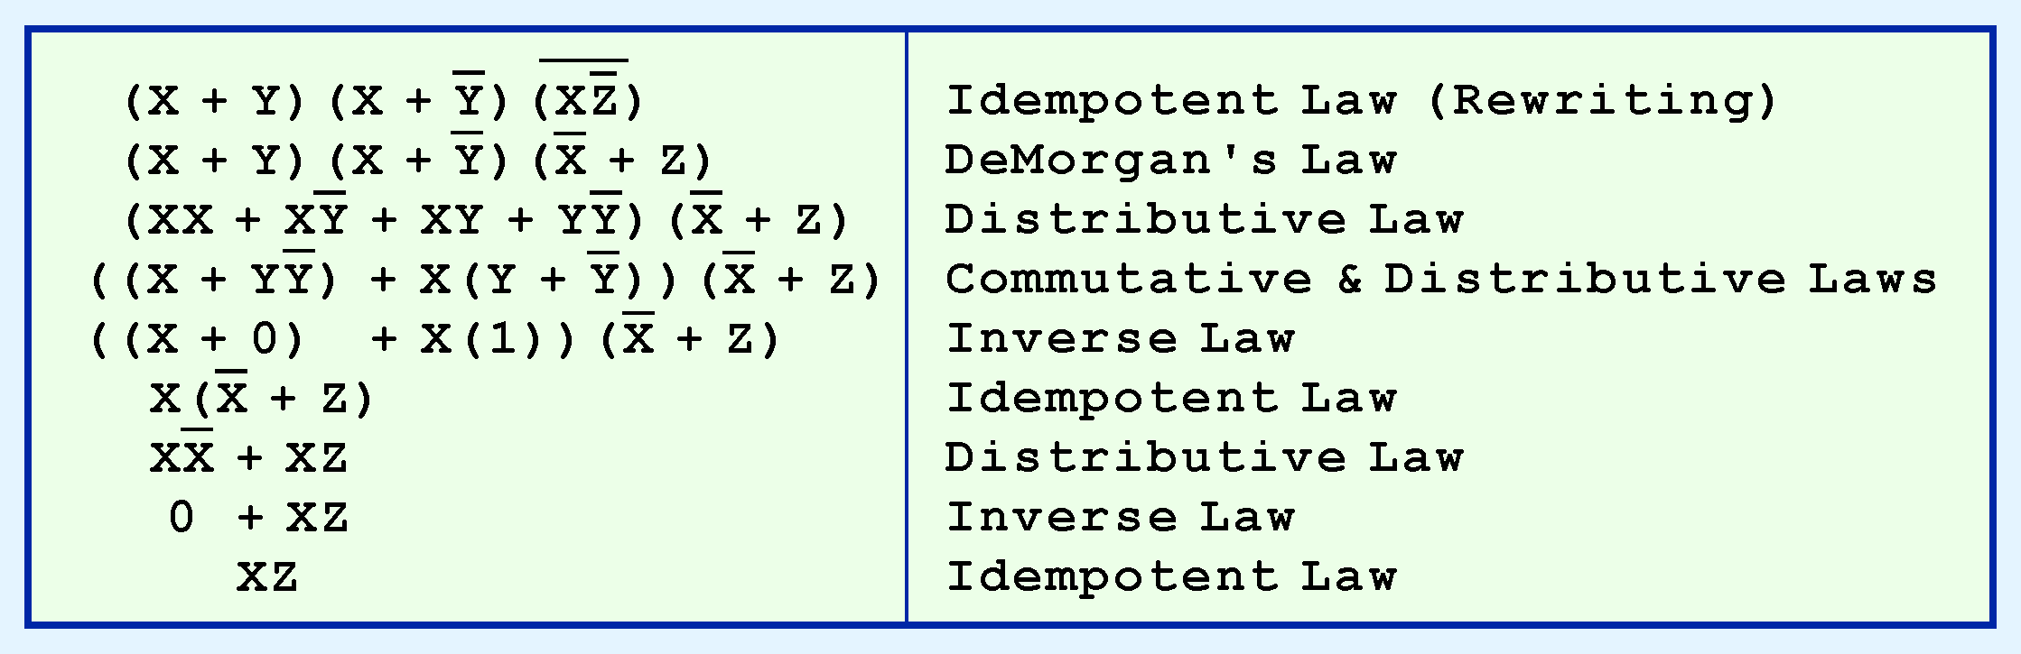
Boolean Algebra
We can use Boolean identities to simplify the function:
as follows:

Slide 14
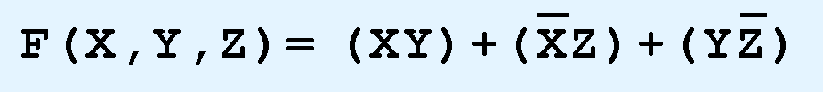

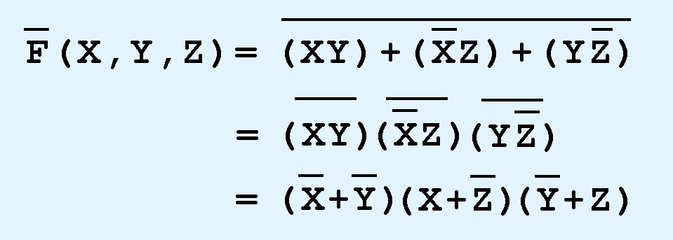







Boolean Algebra
DeMorgan’s law can be extended to any number of variables.
Replace each variable by its complement and change all ANDs to ORs and all ORs to ANDs.
Thus, we find the the complement of:
is:

Slide 15
Conclusion
Computers uses implementations of Boolean logic.
Boolean functions are completely described by truth tables.
Logic gates are small circuits that implement Boolean operators.
The proper implementation of Boolean Laws in Boolean expressions, reduce the cost, complexity and power consumption.
The operators use in Boolean algebra are AND, OR, and NOT.

